Slide 1


Lightning Talk
Technical Challenges
Team: sdmay21-51
Logan Anderson, Nicholas Heger, Steven Sheets, James Volpe, Jared Weiland

Slide 2
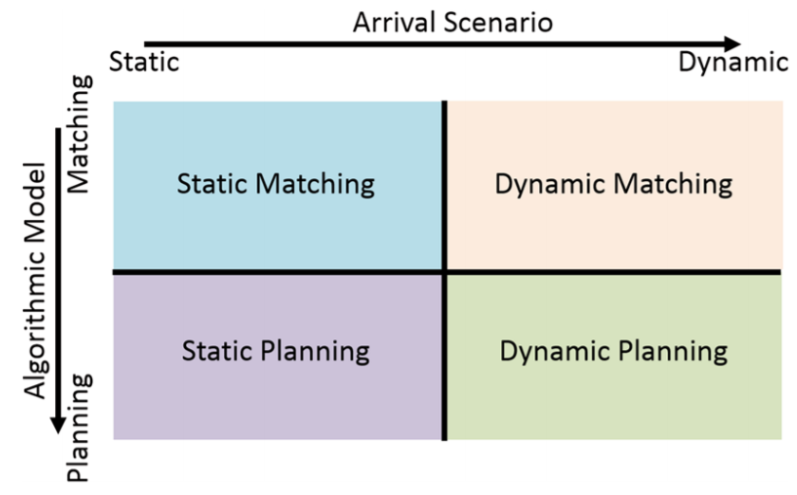
Largest Technical Challenge
How to design an effective system that will enable the users to pick and choose between the different variants…

Slide 3
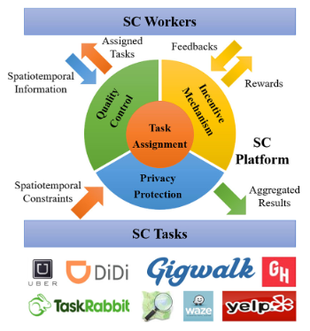
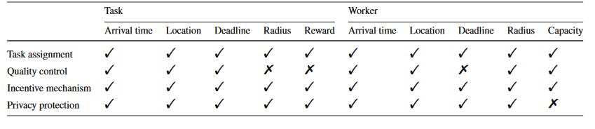
Task Assignment Problem
Challenging due to many considerations
Workers
Tasks
Task Assignment
Quality Control
Incentive Mechanism
Privacy Protection

Slide 4
Static vs. Dynamic Planning/Matching, a Brief Explanation
On the following slides you will be presented with a few tables that explain this problematic concept that complexifies just about every aspect of our project...

Slide 5
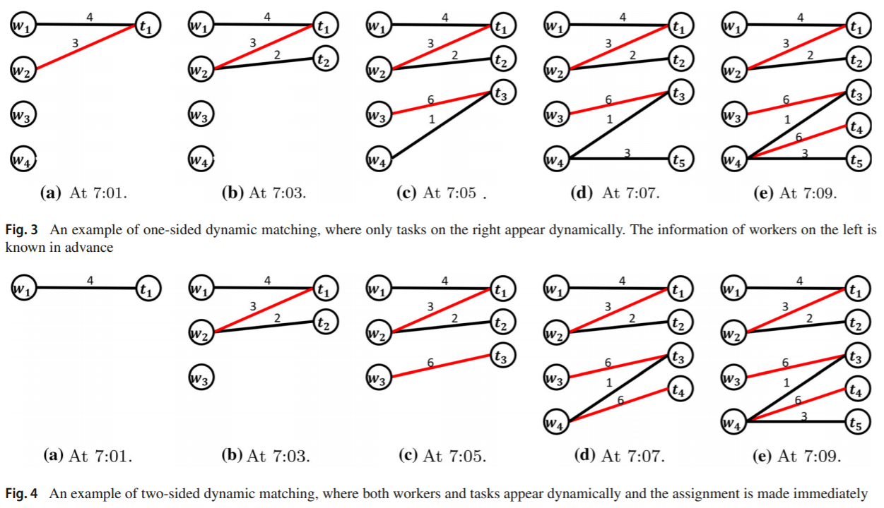

Slide 6
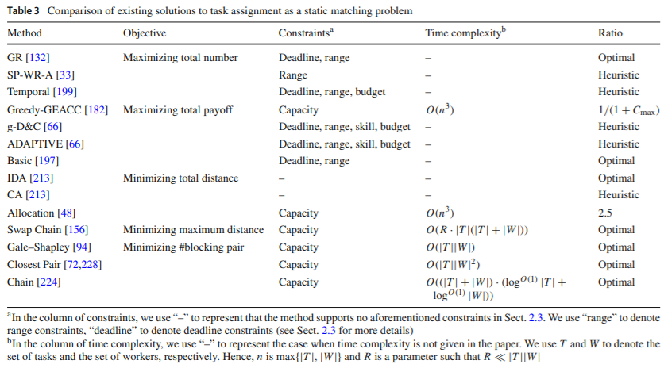

Slide 7
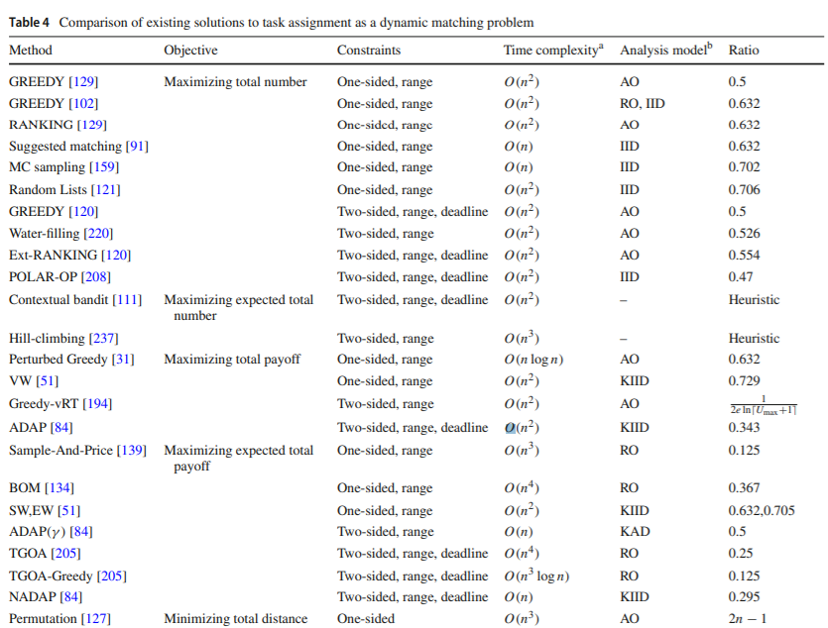

Slide 8
